Slide 1

Reward Program Analysis
Presenter: Yunpeng Li
Mentor: Mert Topcu
Notes:
Hello everyone, my name is Yunpeng Li. I am very happy to join this project.
Travel Tide was founded in 2021, a online travel booking platform .

Slide 2
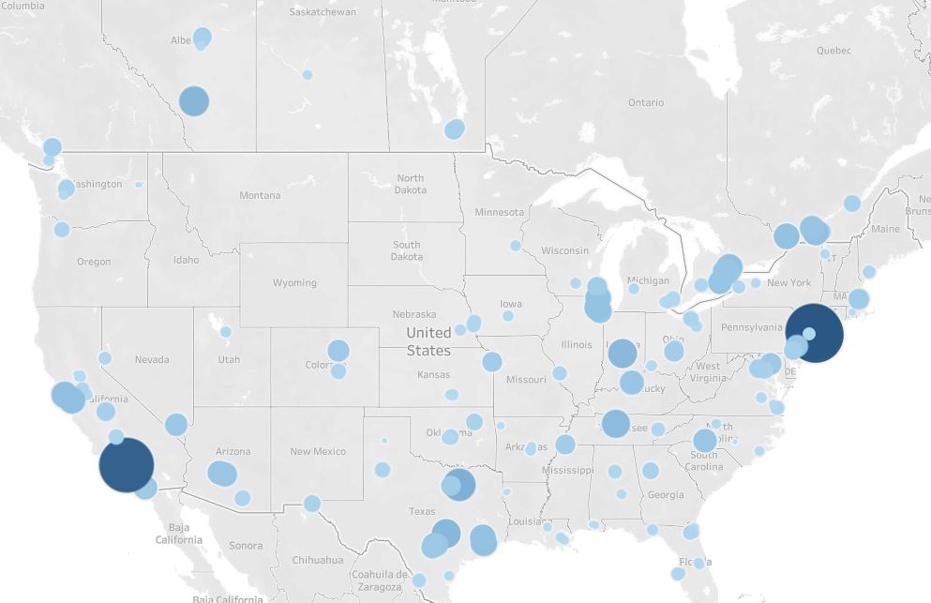


Notes:
The users are from North *America.

Slide 3
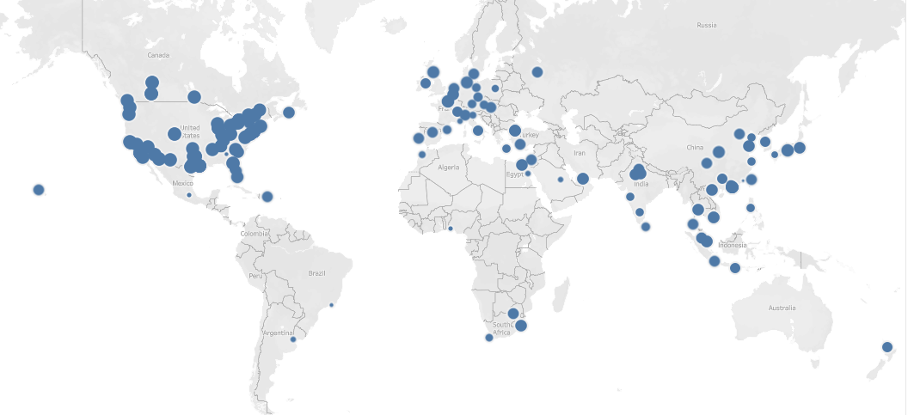
Notes:
With its huge travel inventory, it provides customers with global online travel booking services.

Slide 4
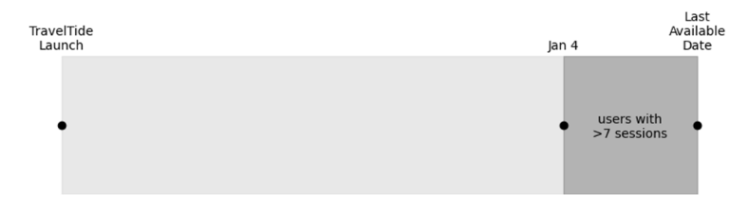
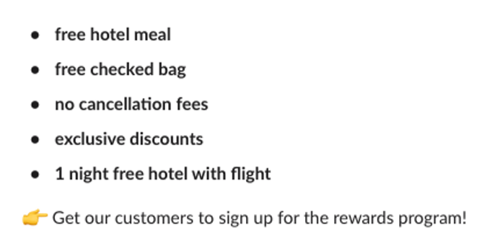
2023
Notes:
The aim of is grouping the users after 2023 and setting the perk for each group.

Slide 5
Grouping method
Age
Family composition
User location
Notes:
After a analysis of the data, I divided the users into 5 groups based on age, family composition, * and user location.

Slide 6
Group 1: Potential New Users
Notes:
The first group is Potential New Users

Slide 7

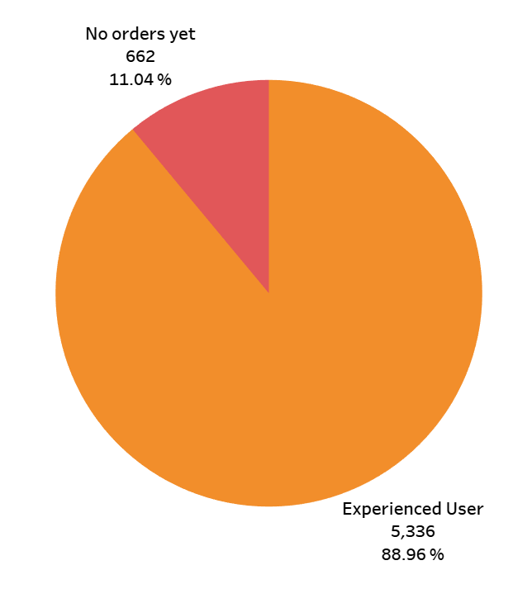
Group 1: Potential New Users
Notes:
Data shows that more than 11% of the users have not placed an order yet. They have a very good understanding of our platform.

Slide 8
Group 1: Potential New Users
From 0
TO 1
Perk: 10% Discount on First Order
Notes:
So offering a 10% discount on their first order could provide the perfect chance to make their first booking.

Slide 9
Group 2: Families with Children
(AGE < 50)
Notes:
The second Group 2 is Users under 50 years old who have a Family with Children

Slide 10

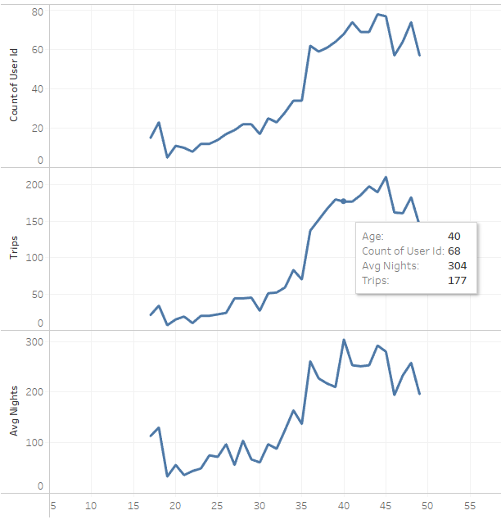
Group 2: Families with Children (AGE < 50)
Notes:
Data shows that. as children grow older, the parents usually improve their children mind by more travel.

Slide 11
Group 2: Families with Children (AGE < 50)
Where to eat?
What to eat?
Perk：Free Hotel Meals
Notes:
This perk of free hotel meals could reduce the problem of where to eat and what to eat, then making travel easier.

Slide 12
Group 3: Economic Hotspots
Notes:
The group 3 is : Economic Hotspots

Slide 13
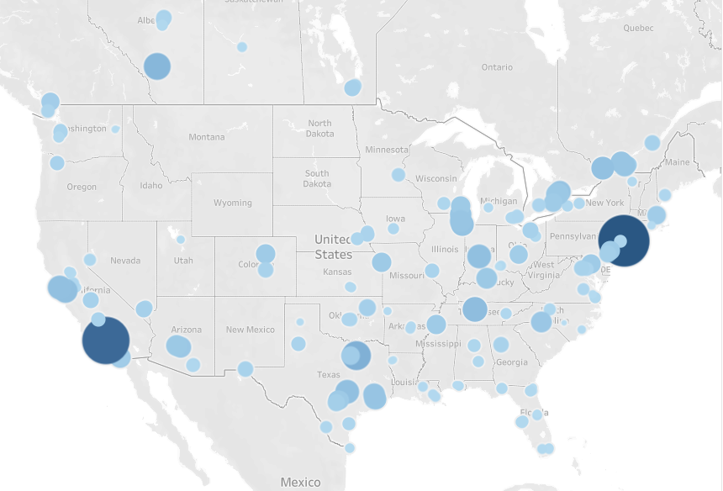
Group 3: Economic Hotspots
Notes:
Back to the users map, we can easily focus on New York and Los Angeles.

Slide 14

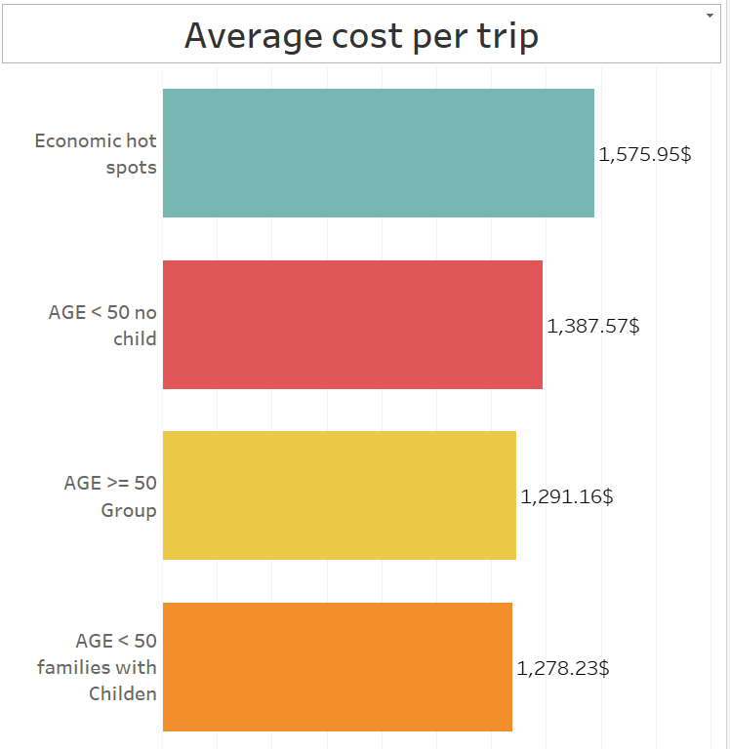
Notes:
The data also shows that their average spending per trip ranks first. Regular perks may not attract their attention. They generally focus on status.

Slide 15

Perk: Exclusive Discounts
Notes:
We can further group them and upgrade their VIP level through travel points to get better services.

Slide 16
Group 4: Adults Under 50
without Children
Notes:
Group 4: Adults Under 50 without Children

Slide 17

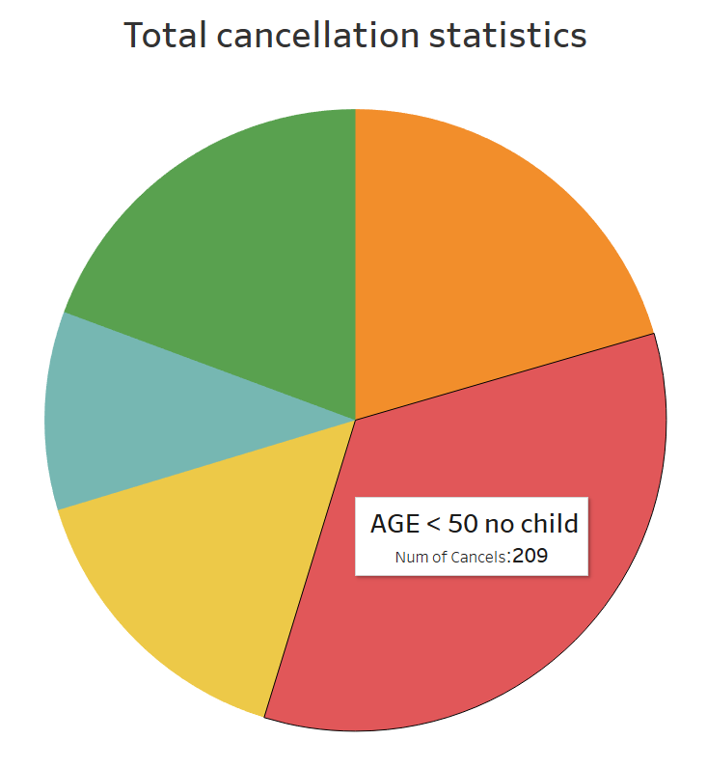
Group 4: Adults Under 50
without Children
Notes:
The users of this group are open-minded and free-spirited. They all enjoy their life. Therefore, this group also has the highest cancellation rate.

Slide 18
Group 4: Adults Under 50
without Children
Open-minded !
Free-spirited !
Perk: No Cancellation Fees
Notes:
So offering free cancellation may encourage them to explore more options.

Slide 19
Group 5: Adults 50 and Older
Notes:
Group 5 is the Adults who are over 50 years old

Slide 20
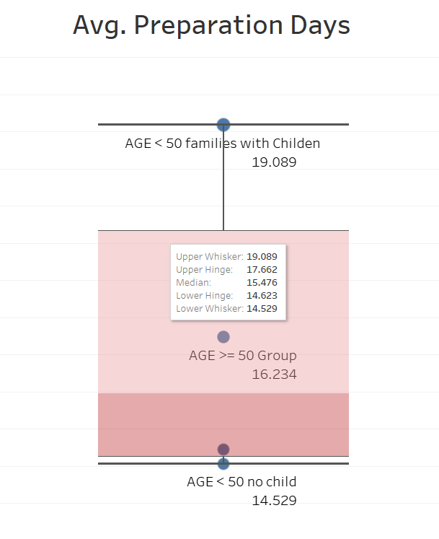

Group 4: Adults 50 and Older
Notes:
Users in this age group tend to have stable consumption patterns and a slower pace of life. They generally require more preparation time.

Slide 21
Group 5: Adults 50 and Older
Perk:
One Free Hotel
Night with
Flight Booking
Notes:
Providing a free hotel night near the airport with their flight booking can enhance their travel experience.

Slide 22
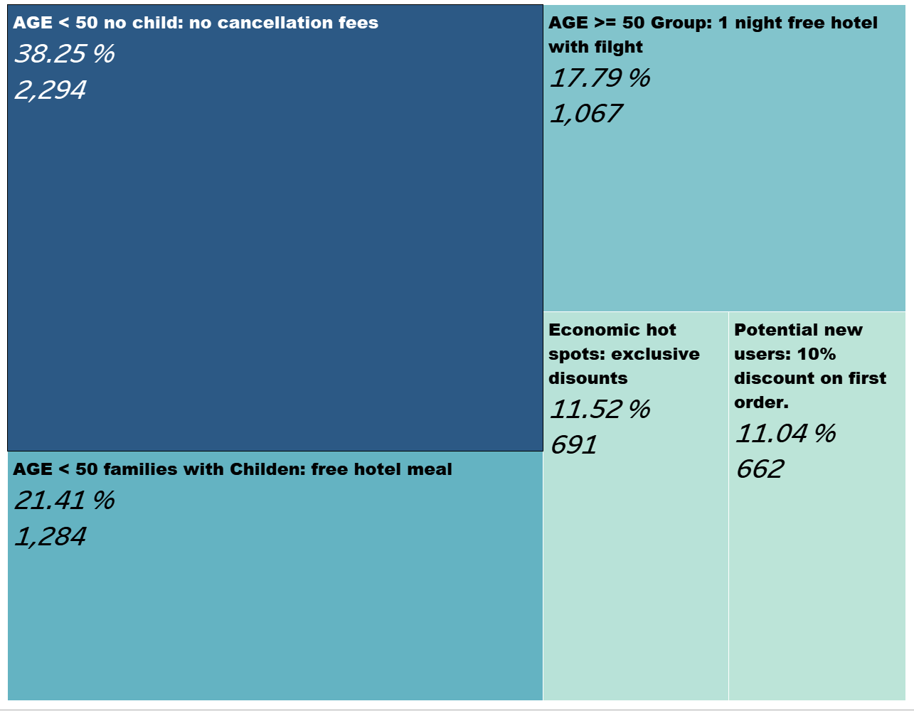
Notes:
This is my reward program analysis. This is the first time to group users, when I get the new data I will update the it.

Slide 23
Thank you
for your attention!
Notes:
Here is all my presentation! Thank you for your attention.

Slide 24
Thank you !
mERT & Thimo
Notes:
And finally, I want to say thank you to my mentor Mert and trainer Thimo. Thank you for your guidance along the way.

